Slide 1
Superfund Effect on Surrounding Communities
By Parker Mills, Avani Patel, Michelle Naclerio, Joseph A Muhia (Group 4)

Slide 2
Trigger: An NBC news article highlighting the disproportionately negative impacts of Superfund Sites on low-income, predominantly black and brown communities
The Dichotomy of two Americas: “One is suburbs where wealth and political leverage guard communities from outside corporate interests and rampant pollution, and the other, of lower-income and predominantly Black and brown residents who have endured decades of discriminatory housing policies only to find their communities squeezed by heavy industry and used as dumping grounds for hazardous waste."
Notes:
Avani
The article highlighted how the minority groups are disproportionately and negatively impacted. Do not have the resources to fight these.
The Dichotomy of two Americas: “One is suburbs where wealth and political leverage guard communities from outside corporate interests and rampant pollution, and the other, of lower-income and predominantly Black and brown residents who have endured decades of discriminatory housing policies only to find their communities squeezed by heavy industry and used as dumping grounds for hazardous waste."

Slide 3
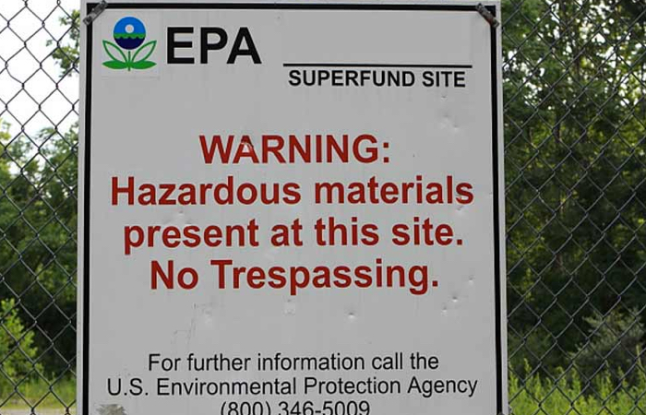
What is a Superfund?
EPA’s Superfund Program is responsible for cleaning up some of the nation’s most contaminated land and responding to environmental emergencies, oil spills and natural disasters.
To protect public health and the environment, the Superfund program focuses on making a visible and lasting difference in communities, ensuring that people can live and work in healthy, vibrant places.
Notes:
Avani

Slide 4
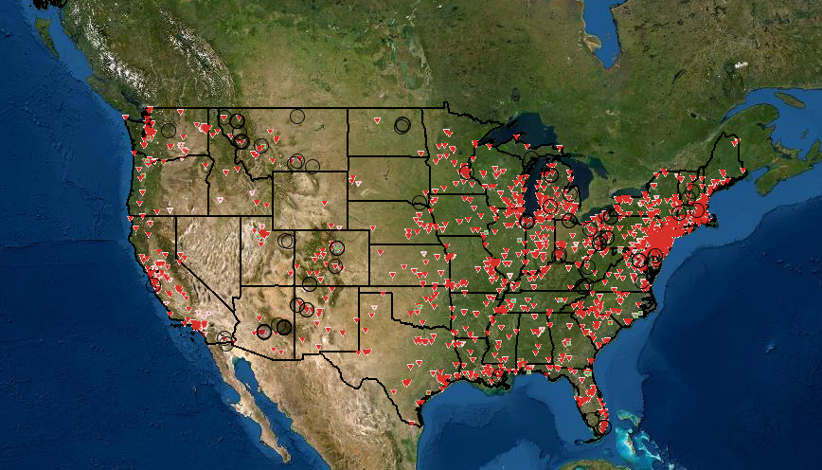
Locations of Superfund Sites in the US
Notes:
Avani
These are Superfund Sites ONLY;; and does NOT include all Cleanup Sites in the country!!!!

Slide 5
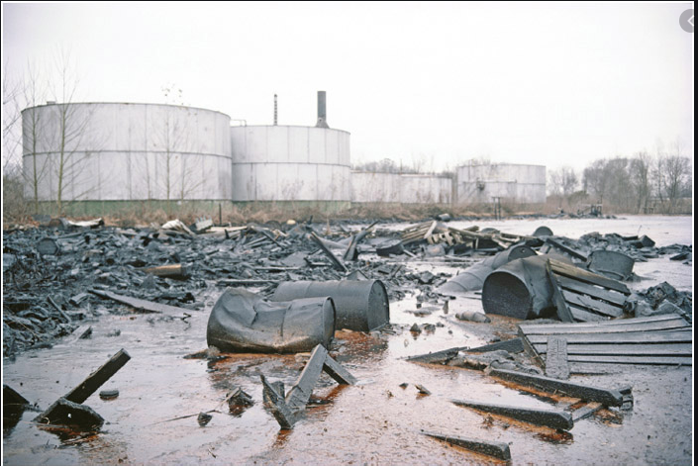
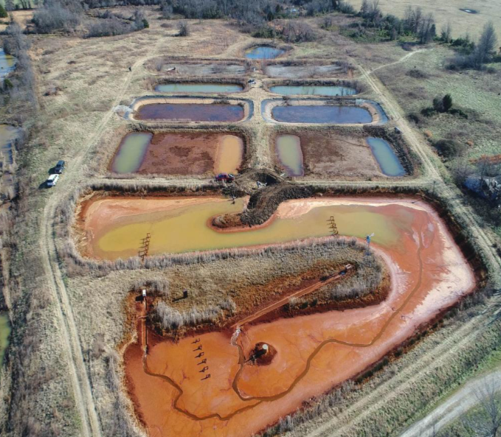
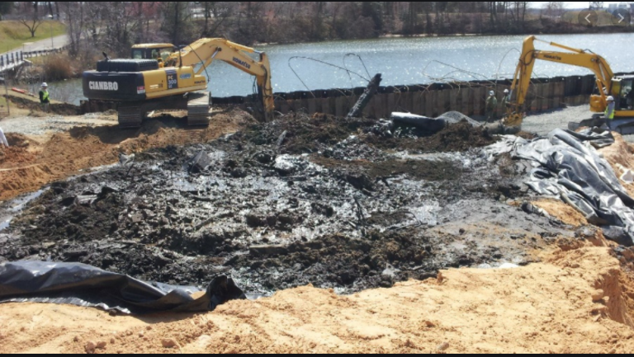
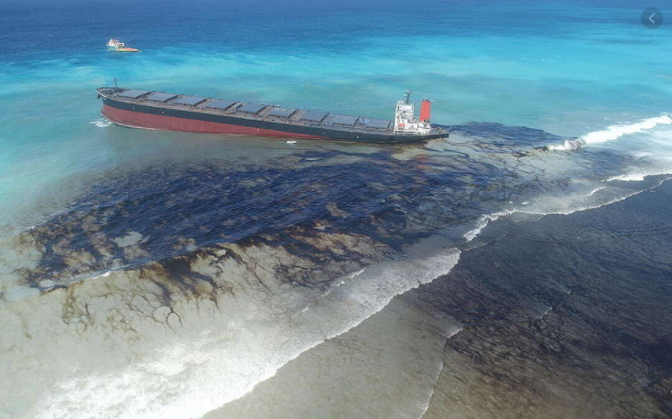
Notes:
Avani
Examples of Cleanup Sites

Slide 6

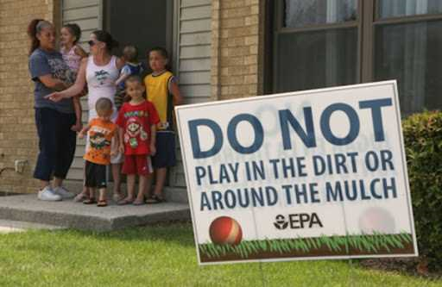
Hypothesis
Are Superfund Sites disproportionately affecting the communities in which they are located?
Conduct a Data Analysis to investigate negative impacts based on
Income,
Race, and
Education
Notes:
Joe
Negative impacts of proximity to Superfund sites:
-Many communities that are affected by Superfund sites are already low-income, therefore the effects of Superfund on the socioeconomic status of affected communities can worsen pre-existing economic issues.
-Race does not seem to have any dimensions according to our study.
-Because of this higher rate of toxicant exposure, as well as their lessened ability to metabolize and excrete toxicants, children living or going to school on or near Superfund sites are particularly vulnerable to health issues, Which affects their attendance to school.

Slide 7
Required Data Analysis to test our hypothesis:
Is there a correlation between median household income and proximity to the sites?
Is there a correlation between education level and proximity to the sites?
Is there a correlation between race and proximity to the sites?
Notes:
Joe
These are three main target questions for this study. Will be answered as we progress.

Slide 8
Data Sources
Kaggle
https://www.kaggle.com/muonneutrino/us-census-demographic-data
Data breakdown by FIPS code:
Percentage of various races in each FIPS location
Average income of each FIPS location
EPA
https://enviro.epa.gov/enviro/ef_metadata_html.ef_metadata_table?p_table_name=sems_active_sites&p_topic=sems
Location of all superfund sites and their status (Active or otherwise)
Downloaded 10 million data points
USDA
https://www.ers.usda.gov/data-products/county-level-data-sets/download-data/
Breakdown of educational attainment by FIPS code:
Some High School
High School DIploma
Some College
College Degree or higher
FCC
https://transition.fcc.gov/oet/info/maps/census/fips/fips.txt
List of all FIPS codes
Notes:
Joe
We would like to acknowledge the 4 Data sources shown here which had a gazillion of our target data queries ranging from FIP codes, Superfund sites (both clean and contaminated) all the way to income and educational.

Slide 9
What are FIPS?
FIPS code - Federal Information Processing Standards code which uniquely identified counties and county equivalents in the United States, certain U.S. possessions, and certain freely associated states.
All our data sets came from government sites
Datasets broken down by FIPS codes
Easy for us to clean and match data
Notes:
Joe
FIPS code - Federal Information Processing Standards code which uniquely identified counties and county equivalents in the United States, certain U.S. possessions, and certain freely associated states.
FIP codes are like a ZIP code or postal code that distinguishes a county
The codes are used for interchange between government agencies and other technical communities in order to ensure uniform practice and organization.

Slide 10
Data Cleanup
Sample size of 100 contaminated FIPS sites
Filtered the EPA dataset to only include active superfund sites
From that dataset, we pulled 100 random FIPS codes
Sample size of 100 clean FIPS sites
To compare against the locations with superfund sites, we needed 100 locations that weren’t near a superfund site
Compared the entire FIPS code dataframe with the EPA dataframe of active sites to have a list of all FIPS codes that do not contain active superfund sites
From the “clean” list, selected a random sample of 100 sites
Used sample FIPS codes to create datasets for our 3 subjects
Each subject (education, income, and race) each have 2 datasets: 1 for locations near superfund sites, and 1 for locations not near superfund sites
Notes:
Michelle
Decided to use FIPS code because that is what the government typically uses. All of our data sets came from a government site and was already broken down by FIPS code making it easy to clean and match our data.

Slide 11
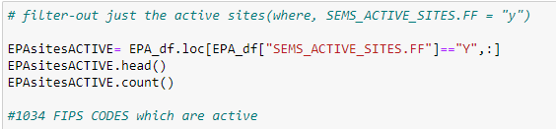
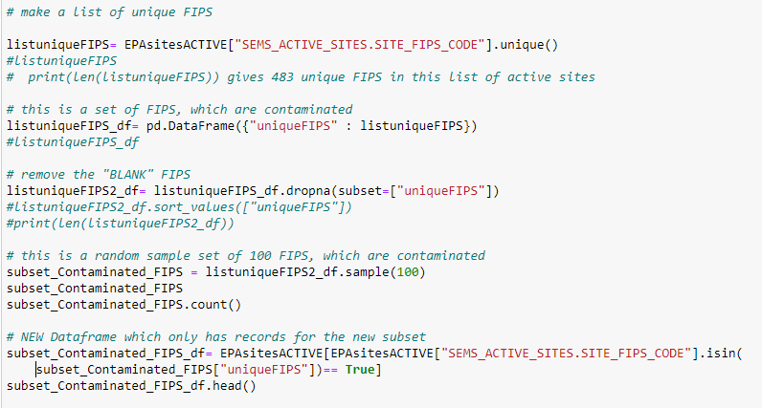
Creating a sample of 100 unique FIPS codes that contain an active Superfund site
Notes:
Michelle

Slide 12
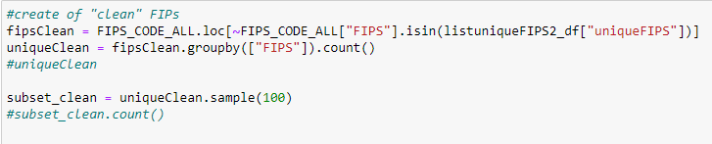
Creating a sample of 100 unique FIPS codes that DO NOT contain a superfund site
Notes:
Michelle

Slide 13
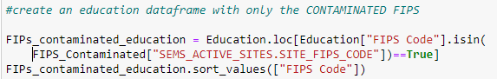
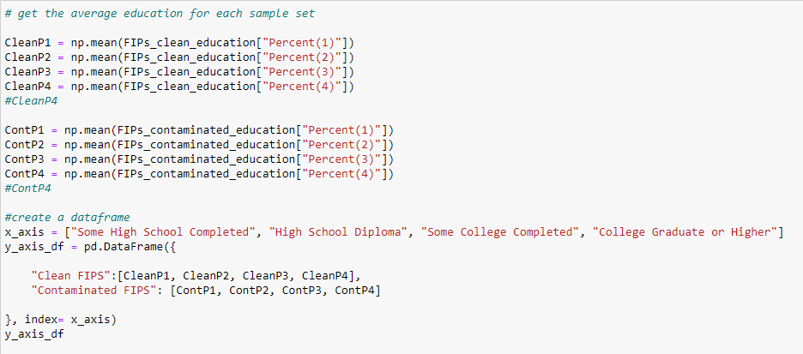
Analyzing Education data
Notes:
Michelle
Used the 8 variables to create both the bar chart and the four different box and whisker plots

Slide 14
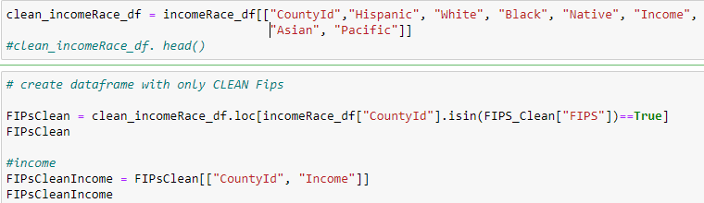
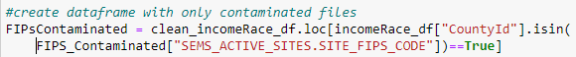
Analyzing Income and Race
Notes:
Michelle
There were a lot of unnecessary columns in the data set that contained info for both income and race. Created separate dataframe for income and race

Slide 15
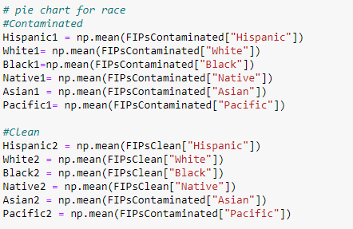
Analyzing Income and Race (cont.)
Notes:
Michelle
Creating pie charts

Slide 16
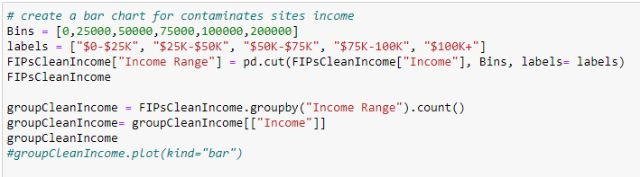
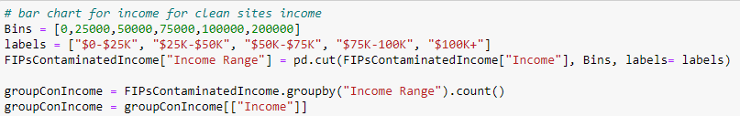
Analyzing Income and Race (cont.)
Notes:
Michelle
Creating two data frames for income range of clean vs contaminated. Merged into 1 df to create bar graph

Slide 17
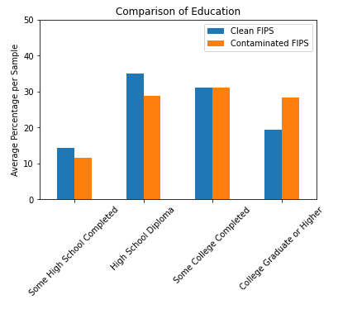
Findings - Education
Some High School
Clean: 14%
Contaminated: 12%
High School Diploma
Clean: 35%
Contaminated: 29%
Some College
Clean: 31%
Contaminated: 31%
College Graduate or Higher
Clean: 19%
Contaminated: 28%
Notes:
Parker
Not a huge difference between education levels. More people completed some high school or have a high school diploma in clean areas however, based on the bar chart, more people completed some college or have a college degree or higher near contaminated sites

Slide 18
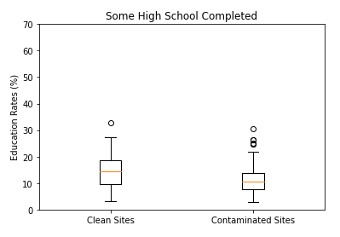
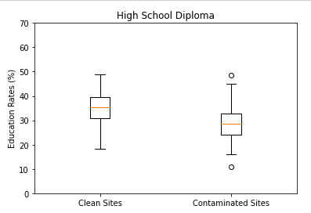
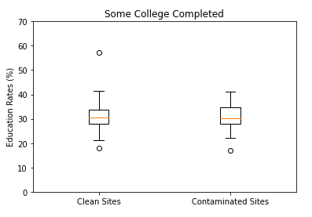
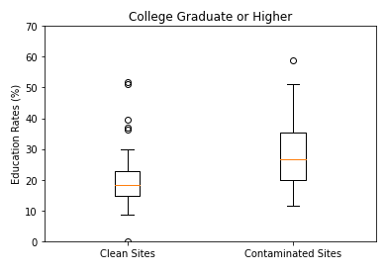
Findings - Education
Notes:
Parker
Looking at each category, the range of data are similar. Based on the IQRs, there are some minor differences in the distribution of the dataset in each category.
However, an important thing to note: These are not representative of population density within each FIPs code (ie data might be biased and statistical significance cannot be determined with the data at hand).

Slide 19
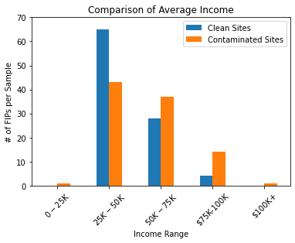
Findings - Income
Avg Household Income: $0-$25K:
Clean Sites: 0
Contaminated Sites: 1
Avg Household Income: $25K-$50K:
Clean Sites: 65
Contaminated Sites: 43
Avg Household Income: $50K- $75K:
Clean Sites: 28
Contaminated Sites: 37
Avg Household Income: $75K-$100K
Clean Sites: 4
Contaminated Sites: 14
Avg Household Income: $100K +
Clean Sites: 1
Contaminated Sites: 0
Notes:
Parker

Slide 20
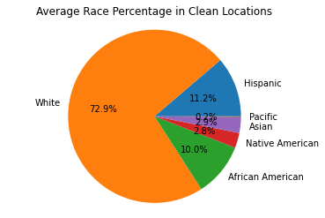
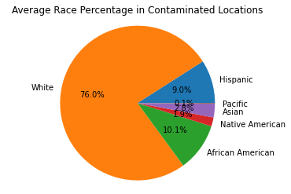
Findings - Race
White
Clean: 73%
Contaminated: 76%
Hispanic:
Clean: 11%
Contaminated: 9%
African American:
Clean: 10%
Contaminated: 10%
Native American:
Clean: 3%
Contaminated: 2%
Asian:
Clean: 3%
Contaminated: 3%
Pacific:
Clean: 0.2%
Contaminated: 0.1%
Notes:
Parker
A comparison of the major groups reported. “Other/non-disclosed” category not included.
The race demographics near superfund sites are virtually the same compared with locations that aren’t near superfund sites. Both locations, are predominantly white with virtually the same level of african american, hispanic, and native american citizens.
Again- the data might be biased; statistical significance cannot be done based on data at hand.

Slide 21
Overview of SuperFund Project
Step 1: Decompose the ask
Step 2: Identify Data sources
Step 3: Define Strategy and Metrics
Step 4: Build Data Retrieval Plan
Step 5: Retrieve the Data
Step 6: Assemble and Clean the Data
Step 7: Analyzed for trends
Step 8 :Limitations of Analysis
Step 9: Making the Call!
Notes:
Decompose the ask:
Determine what factors contributed/effect livelihood.
Income level: Determine poverty
Education levels: Are there factors to being educated enough to understand what is going on in their neighborhoods and if they know what rights they have.
Race: Are these areas that are affected showing trends in race?
Locations: How we define the location? Fips vs zip code
Identify Data Sources:
Make sure all data sources had the correct data set to pull from. (Zip code Vs FIPs)
Find data sources that had more than one variable to pull from (income/data came from one excel file)
Define Strategy and Metrics
Pull a sample of 100 fips
Build Data Retrieval Plan
Retrieve sample size of contaminated FIPs codes
Retrieve sample size of clean FIPs codes
Pull income, race, education data to reflect clean vs contaminated FIPs codes
Retrieve the Data
Assemble and Clean the Data
Pull only the columns vs rows(FIPs) needed
For education and income we had to use binning
Merge data to be able to compare contaminated vs clean
Analyze for trends
Limitations
Making the call!

Slide 22
Final Conclusions
No significant differences found in Education levels between the two datasets
The average of the completed education level was similar for each dataset
Range of data in each category was also similar for each dataset
While the lower income range (<50k) has more “Clean” FIPs; the higher income range (>50k) has more “Contaminated” FIPs
No significant differences found in Racial demographics between the two datasets
Majority white population (>75%) in both datasets
Breakdown of minority groups is also similar for each dataset
Notes:
Avani

Slide 23
Caveats
Only one randomly-generated sample set (n=100) for each type of Data (Clean versus Contaminated Sites). Ideally, the analysis should be completed on numerous random sample datasets per type of Data, in order to achieve more concrete conclusions.
Datasets are organized by FIPS Code, the scale of which may not be refined enough to truly understand the impacts of these Sites (ideally, look at a distance from site ; however, we were unable to find complete datasets by distance).
The population density of each FIPS code location varies, which could skew the data given our small sample size.
Notes:
Avani

Slide 24
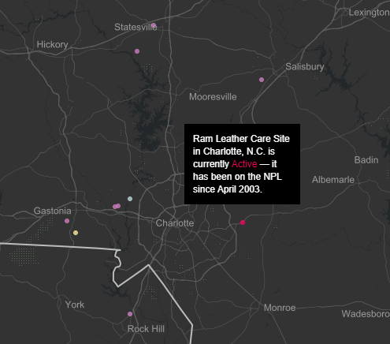
Your Takeaway
NPL - national priority list
Use National Geographic’s site to find superfund sites near you
https://www.nationalgeographic.com/superfund/
Notes:
Avani

Slide 25

Questions?
Notes:
https://www.nationalgeographic.com/superfund/ (if you don’t want to sleep, check this out)

